Slide 1
Mathematics (9-1) - iGCSE
2018-20
Year 09
Unit 11 – Answers

Slide 2
11 - Prior knowledge check
Page 670
£2.60
£67.50
5 minutes
2000g
6 pint bottle is cheaper, e.g. cost of 2 pints: 4 pint bottle 49p, 6 pint bottle 48p
a. 6 days b. 3 days
a. 1:1000 b. 1:10 c. 1:1000 d. 1:60 e. 1:60

Slide 3
11 - Prior knowledge check
Page 670
a. 1.8m b. 280m c. 54.6km
a. 48 inches b. 15 feet c. 4 feet 10 inches
a. 80 fluid ounces b. 40 pints c. 2 gallons 4 pints
a. 64km b. 30 miles
a. 90 minutes b. 3000 seconds c. 3 hours 45 minutes
a. $806.50 b. £49.60

Slide 4
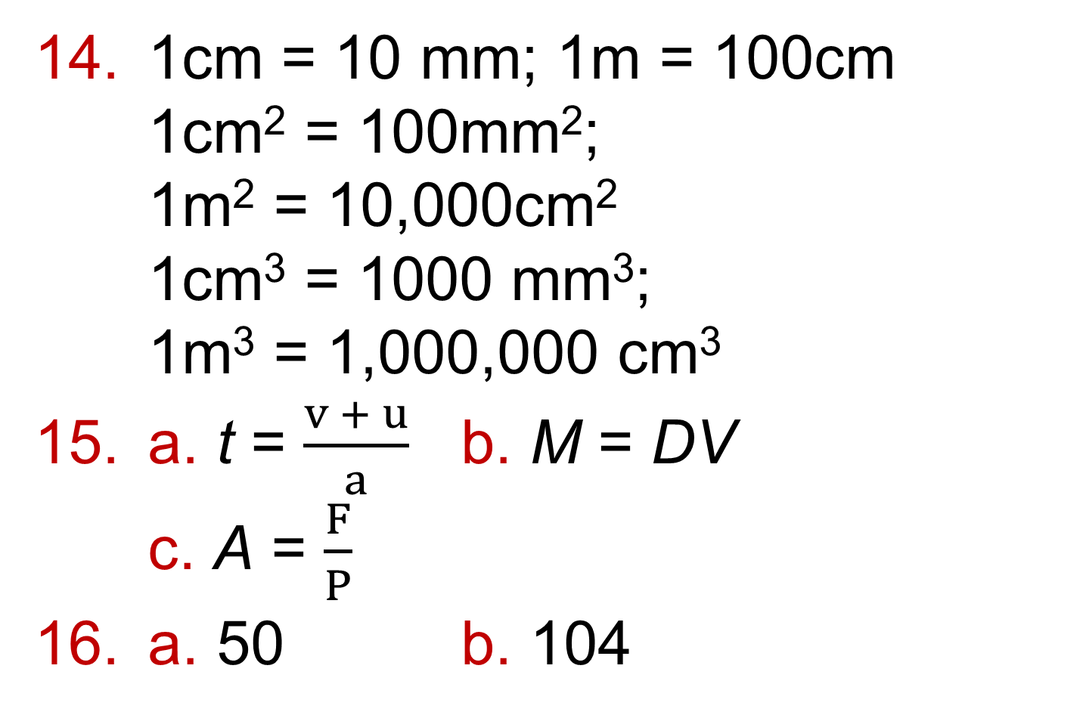
11 - Prior knowledge check
Page 670
1cm = 10 mm; 1m = 100cm 1cm² = 100mm²; 1m² = 10,000cm² 1cm³ = 1000 mm³; 1m³ = 1,000,000 cm³
a. t = $\frac{v + u}{a}$ b. M = DV c. A = $\frac{F}{P}$
a. 50 b. 104

Slide 5
11.1 – Growth and Decay
Page 670
a. 1.3 b. 0.86 c. 1.072 d. 0.975
a. 0.65 b. £4225 c. 0.85 d. £3591.25 e. 0.5525
a. 112³ = 1.404 (3 d.p.) b. 0.85⁴ = 0.522 (3 d.p.)
£36,949.50
No; 1.15 x 1.22 = 1.403, which is equivalent to a 40.3% increase.

Slide 6
11.1 – Growth and Decay
Page 670
a. 1.0815 b. 0.68 c. 1.0246
£38,024
£5,412
£2,719.62 (to the nearest penny)
£3,792.88 (to the nearest penny)
Students‘ own answers
£232.33 (to the nearest penny)

Slide 7
11.1 – Growth and Decay
Page 670
a. £209.70
The cost of her train ticket before the increase was £225 ÷ 1.125 = £200, so her train ticket has gone up by £25. Her pay before the increase was £535.50 ÷ 1.05 = £510, so her pay has gone up by £25.50. Her pay increase is greater than the increase in the cost of the train ticket.

Slide 8
11.1 – Growth and Decay
Page 670
£3,753.67
5 years
a. 1263.5 b. 21 hours
a. 301 b. The nearest whole number
449

Slide 9
11.2 – Compound Measures
Page 670
a. 6 b. -30 c. -0.125
a. 16km/h b. 30km c. 3 hours
a. 7 hours 30 minutes b. 6 hours 12 minutes
a. £399.50 b. 3 hours
a. i. 1.5 litres ii. 3.75 litres b. 40 hours
a. 16km/litre b. 4.1 litres (1 d.p.)

Slide 10
11.2 – Compound Measures
Page 670
a. 0.65 km/h b. 7.8 km/h c. 256 km/h
a. 3600 m/h b. 43200m/h c. 28800m/h d. 16200 m/h
900 km/h
Metres per second | Kilometres per second
15 | 54
20 | 72
30 | 108
45 | 162

Slide 11
11.2 – Compound Measures
Page 670
Falcon is fastest. Car: 350 km/h = 97.2 m/s (1 d.p.); Falcon: 388.8 km/h = 108 m/s
a. $\frac{1000x}{3600}$ . b. $\frac{3600y}{1000}$
53.8 km/h (1 d.p.)
26.4 km
1.8 km/h
44.7 m/s (1 d.p.)
2m/s²
2.5 m/s

Slide 12
11.3 – More Compound Measures
Page 670
a. 7500g b. 6.25m² c. 0.095 m!
a. m = 30 b. v = 16
8.3 g/cm³
24 g/cm³
2047.5g
675 cm³

Slide 13
11.3 – More Compound Measures
Page 670
8,940,000g/mJ
82,700 kg/m³
1000xkg/m³
Platinum is denser: gold density = 19.32 g/cm³; platinum density = 21.45 g/cm
1.01 g/cm³ (2 dp)
17.3 N/m² (1 d.p.)

Slide 14
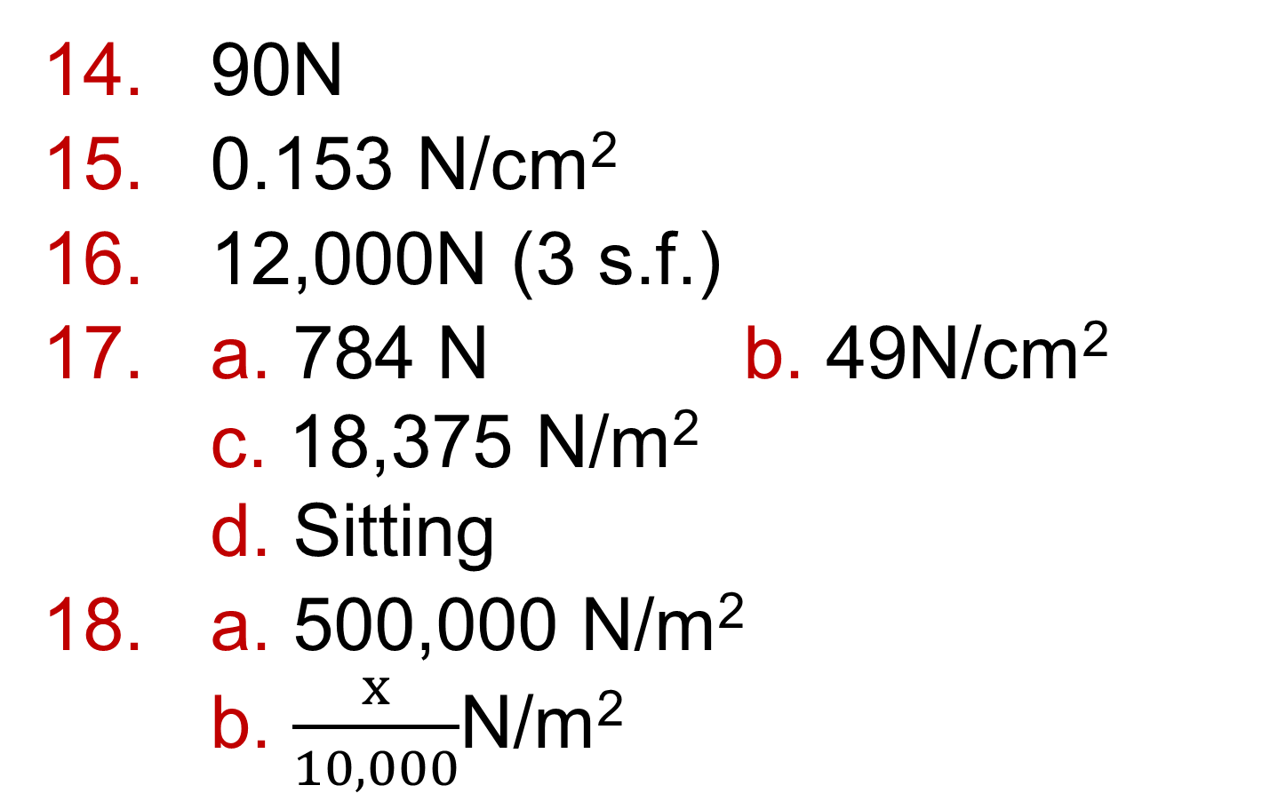
11.3 – More Compound Measures
Page 671
90N
0.153 N/cm²
12,000N (3 s.f.)
a. 784 N b. 49N/cm² c. 18,375 N/m² d. Sitting
a. 500,000 N/m² b. $\frac{x}{10,000}$N/m²

Slide 15
11.4 – Ratio and Proportion
Page 671
a. B b. A c. C
a. 2 b. 3 c. 5 d. 9
a. A and D
Graph of data in table A with points plotted at (2,8) (4, 16) (6, 24) and (8, 32) Graph of data in table D with points plotted at (2,10) (4, 20) (6, 30) and (8,40)
Straight lines
A, y = 4x; B, y = 5x

Slide 16
11.4 – Ratio and Proportion
Page 671
a. A = $\frac{3}{5}$B b. P = $\frac{7}{4}$Q c. X:Y = 9:5
a. 1:1.6
Graph with miles on the horizontal axis and kilometres on the vertical axis. Points plotted at (8,10) (10,16) (15, 24) and (20,32) and joined with a straight line,
Yes, they are in direct proportion. When plotted the graph is a straight line from origin,
Gradient = 1.6
Kilometres = 1.6 x miles

Slide 17
11.4 – Ratio and Proportion
Page 671
a. Yes, s is in direct proportion to t as $\frac{8}{10}$ = $\frac{16}{20}$ = $\frac{24}{30}$ = $\frac{32}{40}$ = $\frac{40}{50}$ b. t = 1.25.9 c. 20 miles
Students’ own answers
a. Students' own answers, e.g.
Table of values: Graph plotted from the table of values is a straight line from origin so in direct proportion, b. 01.3x c. £71.50
x | 0 | 5 | 10 | 20
C | 0 | 6.5 | 13 | 26

Slide 18
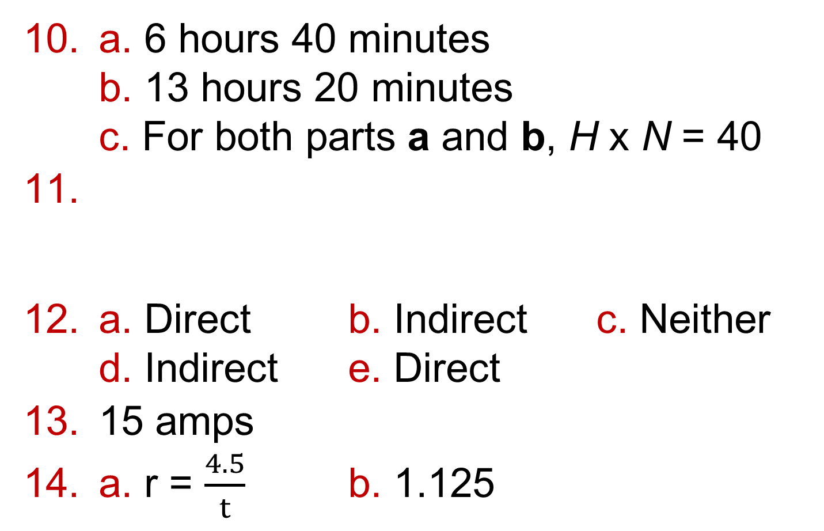
11.4 – Ratio and Proportion
Page 671
a. 6 hours 40 minutes b. 13 hours 20 minutes c. For both parts a and b, H x N = 40
a. Direct b. Indirect c. Neither d. Indirect e. Direct
15 amps
a. r = $\frac{4.5}{t}$ b. 1.125
A | 10 | 20 | 14 | 2 | 5
B | 14 | 7 | 10 | 70 | 28

Slide 19
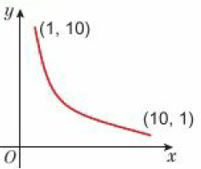
11.4 – Ratio and Proportion
Page 671
a. b. c. y = 05 d. y = 20
a. 960 seconds b. 560 seconds
x | 1 | 2 | 5 | 10
y | 10 | 5 | 2 | 1

Slide 20
11 – Problem Solving
Page 671
Profit of £23.07
60cm
528 inches per second
3 hours 30 minutes
5.472 tonnes
3p

Slide 21
11 – Check Up
Page 671
£7200
£3869.28
6059
5 years
a. £342.23 b. 6 hours
320 seconds
0.8g/cm³
a. 8050kg/m² b. 1006.25g or 1.00625kg
9.375 N/m²

Slide 22
11 – Check Up
Page 671
Usain Bolt is faster: Usain Bolt: 12.3 m/s = 44.2 km/h; White shark: 11.1 m/s = 40 km/h
a. Yes. Values are in same ratio. b. E = 13P c. €32.50
When d =8. P = 0.8, so P = 0.1d When d = 75, the pressure on the watch will be 75 x 0.1 = 7.5 bars. This is less than 8.5 bars, so the watch will still work.
10.5 amps
5 km race leader board: Allia, Chaya, Hafsa, Billie 10km race leader board: Fion, Daisy, Grade, Ellie

Slide 23
11 – Strengthen
Page 671
Percentages
a. 1.2 b. 1.09 c. 1.037
a. 0.77 b. 0.94 c. 0.925
a. 1.308 b. 1.265 c. 0.7238 d. 0.8099 e. 1.0304
£605.63

Slide 24
11 – Strengthen
Page 671
£6144
557
5 years
Year | Amount at start of year | Amount plus interest | Total amount at end of year.
4 | £437.09 | 437.09 x 1.03 = 400 x 1.03⁴ | £450.20
5 | £450.20 | 450.20 x 1.03 = 400 x 1.03⁵ | £463.71
6 | £463.71 | 463.20 x 1.03 = 400 x 1.03⁶ | £477.62

Slide 25
11 – Strengthen
Page 672
Compound Measures
£302.60
a. 3l/min b. 4 minutes
Metal | Mass (g) | Volume (cm³) | Density (g/cm³)
Copper | 1090 | 122 | 8.96
Lead | 450 | 39.8 | 11.3
Mercury | 110 | 8.15 | 13.5

Slide 26
11 – Strengthen
Page 671
a. 1000g – 1 kg b. 10,000cm² = 1m² c. 1,000,000cm³ = 1m³
Force (N) | Area (cm²) | Pressure (N.cm²)
104 | 13 | 8
48 | 12 | 4
65 | 5 | 13

Slide 27
11 – Strengthen
Page 671
a. i. 12kg ii. 15,000g b. i. 27gcm² ii. 450kg/m² iii. 50,000kg/m³ = 1m³ iv. 0.02g/cm³
Km/h | m/h | m/min | m/s
18 | 18,000 | 300 | 5
36 | 36,000 | 600 | 10
24 | 24,000 | 400 | 6.67
57.6 | 57,600 | 960 | 16

Slide 28
11 – Strengthen
Page 671
Ratio and proportion
W = 24, X = 22.5, Y = 30, Z = 18
200 seconds
a. Table of values: Graph plotted from the table of vales; points joined with a straight line through the origin. b. P = 1.25E
64N
W = 6, X = 3, Y = 4, Z = 4
P | 10 | 25 | 50 | 100
E | 8 | 20 | 40 | 80

Slide 29
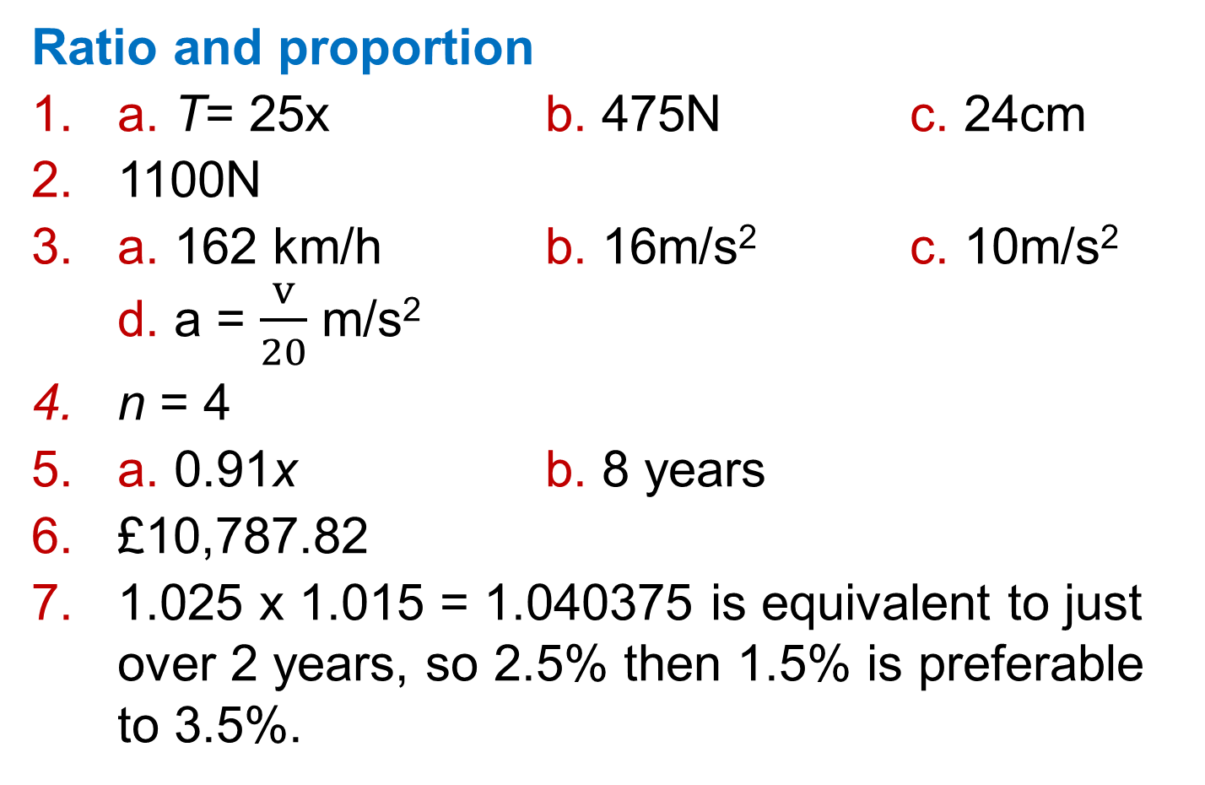
11 – Extend
Page 671
Ratio and proportion
a. T= 25x b. 475N c. 24cm
1100N
a. 162 km/h b. 16m/s² c. 10m/s² d. a = $\frac{v}{20}$ m/s²
n = 4
a. 0.91x b. 8 years
£10,787.82
1.025 x 1.015 = 1.040375 is equivalent to just over 2 years, so 2.5% then 1.5% is preferable to 3.5%.

Slide 30
11 – Extend
Page 671
363g
a.
Graph plotted from the table of values; points joined with a line.
3.5 years
C
Number of years, n | 0 | 1 | 2 | 3 | 4
Value, y | 3000 | 3100 | 3200 | 3300 | 3400

Slide 31
11 – Extend
Page 671
a. Sam is correct. Exterior angle x number of sides = constant, so if number of sides is doubled exterior angle is halved
180
148
1 hour 45 minutes

Slide 32
11 – Unit Test
Page 671
Sample student answers
Student B gives the better answer as they have written a sentence at the end answering the question. It is also easier to follow Student B's working as they have labelled their working as 'International Bank’ and 'Friendly Bank'.

